Slide 1
Object Oriented Programming Lecture – 28
Prof. Varsha Dange

Slide 2
What is Collection?
Initially, collection framework is simply called Java.util package or Collection API. Later on, Sun Microsystem had introduced the collection framework in Java 1.2. It was developed and designed by “Joshua Bloch”.
Later on, after Java 1.2, it is known as collections framework. From Java 1.5 onwards, The Sun Microsystem added some more new concepts called Generics.
Due to adding Generics concepts, a lot of changes happened in the collections classes. That’s why Java 1.5 onwards, people started calling it Collections and Generics.

Slide 3
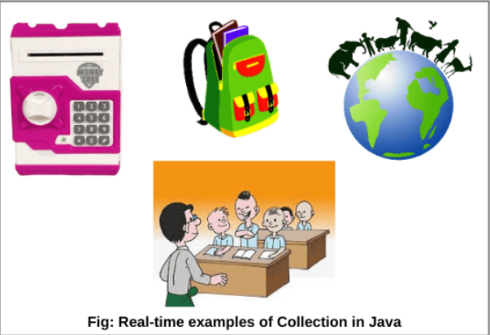
What is Collection?
A collection is a group of objects.
In Java, these objects are called elements of the collection.
kiddy bank is a collection and the coins are objects.
Schoolbag is a collection and books are objects.
the classroom is a collection and students are objects.
world is a collection and humans, animals and different things are different objects.

Slide 4
Types of Objects Stored in Collection (Container) Object
There are two types of objects that can be stored in a collection or container object.
1. Homogeneous objects: group of multiple objects that belong to the same class.
Eg- Student s1, Student s2, and Student s3 of the same class ‘Student’.
2. Heterogeneous objects: group of different objects that belong to different classes.
Eg- Student s1, and another one object Employee e1.
It further divided as duplicate or unique object

Slide 5
What is Collections Framework in Java?
collections framework represents group of objects as single entity.
A framework in java is a set of several classes and interfaces which provide a ready-made architecture.
It is present in java.util package.
It allows us to store and manipulate group of objects.
It has various classes like Array List, Stack, Vector ,Hash Set and interface like Set, List and Queue.
Various performance like sorting, searching, insertion etc can be using collections framework.

Slide 6
Difference between Arrays & Collections in Java
Array | Collections
Arrays can represents group of objects as a single entity | Collections Arrays can represents group of objects as a single entity
Arrays can hold both primitives and object types . | Collections can hold only objects but not primitive.
Arrays are fixed in size | Collections are growable in nature. We can increase or decrease size.
Arrays are recommended to use with respect to performance | Collections are not recommended to use with respect to performance.
Arrays can store only homogeneous data elements (similar type of data) | Collections can hold both homogeneous and heterogeneous elements.
Arrays do not support any method so operation become complex. | Collections support various kinds of methods.
If the size is 10 and only 5 elements store then it is a waste of memory. | It adjusts size according to elements.
Memory management is poor. | Memory management is effective.

Slide 7
Advantage of Collection Framework in Java
The collections framework reduces the development time and the burden of designers, programmers, and users.
Your code is easier to maintain because it provides useful data structure (A data structure is a particular way of organizing data in a computer) and interfaces which reduce programming efforts.
The size of the container is growable in nature.
It implements high-performance of useful data structures and algorithms that increase the performance.
It enables software reuse.

Slide 8
Difference between Collection and collections
Collection | Collections
Collection is root interface | Collections is a class
Collection is used to represent a group of objects as a single entity | Collections defines different utility methods for collection objects eg-sort()
Helps to derive the data structure of the collection framework | Helps in data structure manipulations using different static methods

Slide 9
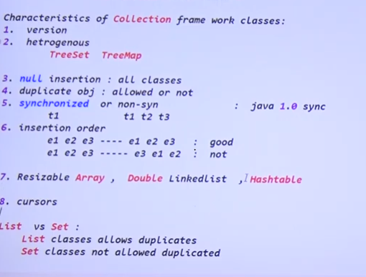
Characteristics of collections f/w classes
-----Different classes from different version
except
--allowed in List but not in set

Slide 10
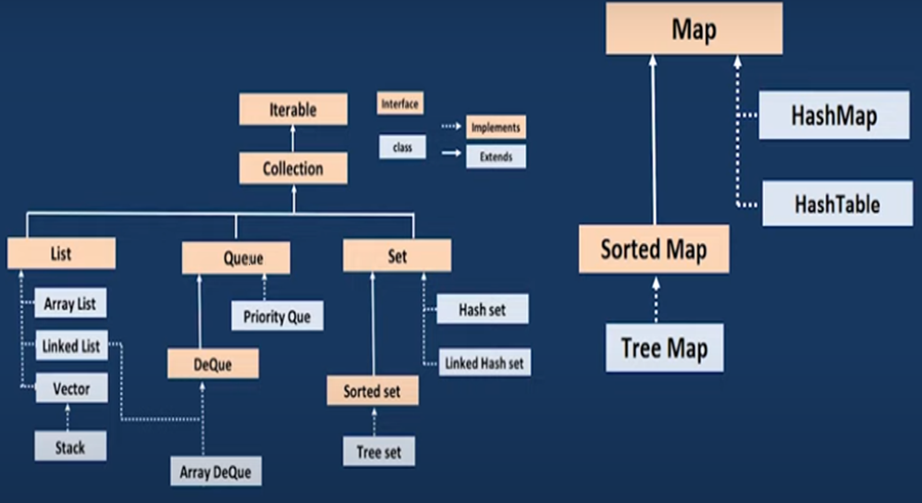
Collection Hierarchy in Java

Slide 11
Collection Hierarchy in Java
Collection Hierarchy
The collection in java is the root interface of the collection framework
List, Set, and Queue are the main child interfaces of the collection interface.
The Map interface is also part of the java collections framework
but it does not inherit the collection interface.
The map interface is preferred when values are stored in the form of keys and value pairs.

Slide 12
Iterable interface
Collection Hierarchy
The Iterable interface is the parent interface for all the collection classes.
The Collection interface extends the Iterable interface
all the subclasses of Collection interface also implement the Iterable interface.
The iterable interface has only one abstract method called iterator().
Iterator<T> iterator()
It returns the iterator over the elements of type T.
The function of the iterator method is to return the iterator object.
Using this iterator object, we can iterate over the elements of the collection.

Slide 13
Collection Interface
Collection Hierarchy
The basic interface of the collections framework is the Collection interface which is the root interface of all collections in the API .
It provides the basic operations for adding and removing elements in the collection.
The Collection interface extends the Iterable interface.
The iterable interface has only one method called iterator().
The function of the iterator method is to return the iterator object.
Using this iterator object, we can iterate over the elements of the collection.

Slide 14
Methods of Collection Interface in Java
Method | Description
add(Object element) : boolean | This method is used to add or insert an element in the collection.
addAll(Collection c) : boolean | This method adds a collection of elements to the collection.
clear() : void | This method clears or removes all the elements from the collection.
contains(Object element) : boolean | It checks that element is present or not in a collection.
containsAll(Collection c) : boolean | This method returns true if the collection contains all of the elements in the given collection
equals(Object element) : boolean | It checks for equality with another object.
hashCode() : int | It returns the hash code number for the collection.
isEmpty() : boolean | It returns true if a collection is empty.
iterator() : Iterator | This method returns an iterator over the elements in this collection.
remove(Object element) : boolean | It removes a specified element from the collection.

Slide 15
Methods of Collection Interface in Java
Method | Description
removeAll(Collection c) : boolean | The removeAll() method removes all elements from the collection.
removeIf(Predicate filter) | This method is used to removes all the elements of this collection that satisfy the given predicate.
retainAll(Collection c) : boolean | This method is used to retains only the elements in this collection that are contained in the specified collection.
size() : int | The size() method returns the total number of elements in the collection.
toArray() : Object[] | It returns the elements of a collection in the form of an array.
max() | This method is used to return the maximum value present in the collection.

Slide 16
List Interface
Collection Hierarchy
The list is a child interface of Collections in java.
It’s elements are arranged sequentially ordered.
the order is retained in which we add elements, and the same sequence we will get while retrieving elements.(FIFO)
We can insert elements into the list at any location.
Duplicate elements are allowed.
JVM differentiates duplicate elements by using ‘index’.
List Interface is implemented by using ArrayList, LinkedList, and Vector class.
It allows for storing null elements.

Slide 17
List Interface
Collection Hierarchy
It provides a special Iterator called a ListIterator .
that allows accessing the elements in the forward direction using hasNext() and next() methods.
In the reverse direction, it accesses elements using hasPrevious() and previous() methods.
We can add, remove elements of the collection, and can also replace the existing elements with the new element using ListIterator.

Slide 18
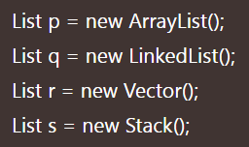
List Interface
How to create a List in Java?
To create a list in java, we can use one of its two concrete subclasses: ArrayList, and LinkedList.

Slide 19
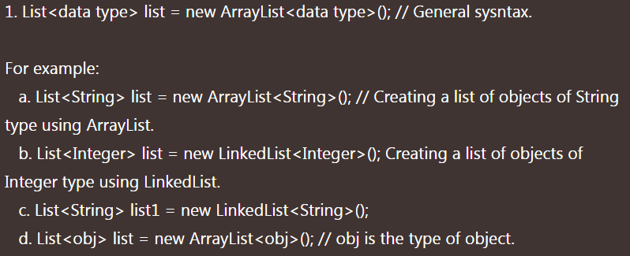
List Interface
How to create Generic List Object in Java?
After the introduction of Generic in Java 1.5, we can restrict the type of object that can be stored in the list.

Slide 20
Generics in Java
Using Generics, it is possible to create classes that work with different data types.
Example1
Example2
The Java Generics programming is introduced in J2SE 5 to deal with type-safe objects.
It makes the code stable by detecting the bugs at compile time.
generics in collection force the java programmer to store a specific type of objects for type safety.

Slide 21
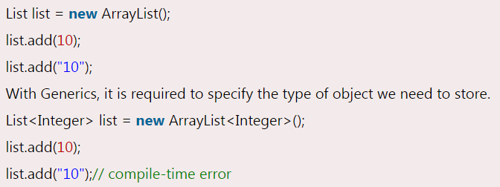
Generics in Java
Advantage of Java Generics
There are mainly 3 advantages of generics. They are as follows:
1) Type-safety: We can hold only a single type of objects in generics.
It doesn’t allow to store other objects.
Without Generics, we can store any type of objects.

Slide 22
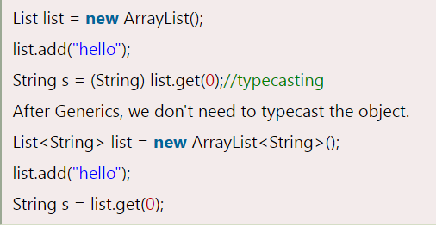
Generics in Java
2) Type casting is not required: There is no need to typecast the object.
Before Generics, we need to type cast.

Slide 23
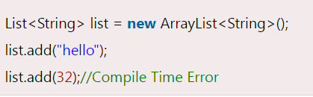
Generics in Java
3) Compile-Time Checking: It is checked at compile time so problem will not occur at runtime.
Example3

Slide 24
Java List Methods
boolean add(Object o): It starts to add the specified element from zero location.
void add(int index, Object o):This method adds/inserts the specified element at a particular position in the list.
boolean addAll(Collection c): Here, Collection c represents a group of elements. This method is used to add/insert a group of elements at the end of the last element.
boolean addAll(int index, Collection c): This method is used to add/insert a group of elements at a particular position in the list and shift the subsequent elements to the right by increasing their indices.
object remove(int index): It is used to remove an element at a specified position in the list.
object get(int index): This method is used to return element/object stored at a specified position in the list.

Slide 25
Java List Methods
int indexOf(Object o): It is used to return the index of a particular element of the first occurrence in the list.
If the element is not present in the list then it will return -1.
int lastIndexOf(Object o): It returns the index of the last occurrence of a specified element in the list.
object set(int index, Object o): This method replaces the existing element at the specified position in the list with new specified element.
Example1
Example2

Slide 26
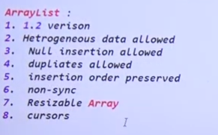
ArrayList in java
ArrayList is a class present in java. util package.
It provides a dynamic array(resizable array ) for storing the element.
It is an array but there is no size limit.
We can add or remove elements easily.
It is more flexible than a traditional array.
dynamic array means if the initial capacity of the array is exceeded, a new array with larger capacity is created automatically and all the elements from the current array are copied to the new array.
ArrayList contains multiple objects and each objects executes toString()
is not type safe.

Slide 27

Java ArrayList Constructor
Java ArrayList class provides three constructors for creating an object of ArrayList. They are as:
ArrayList()
ArrayList(int initialCapacity)
ArrayList(Collection c)
The syntax for creating an instance of ArrayList class is as:
It creates an empty ArrayList with a default initial capacity of 10.

Slide 28
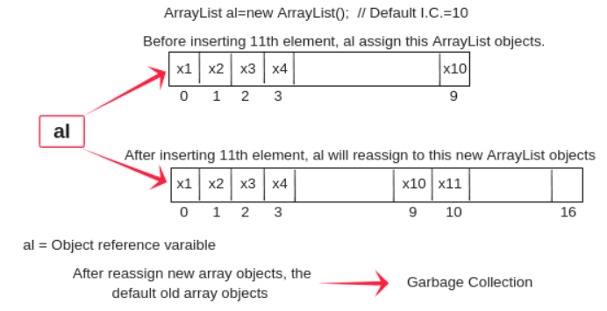
ArrayList in java
Once ArrayList is reached its maximum capacity, the ArrayList class automatically creates a new array with a larger capacity.
New capacity = (current capacity*3/2) + 1 = 10*3/2 + 1 = 16

Slide 29
Features of ArrayList
Resizable-array: ArrayList is a resizable array or growable array at runtime.
Index-based structure: It uses an index-based structure in java.
Duplicate elements: Duplicate elements are allowed in the array list.
Null elements: Any number of null elements can be added.
Insertion order: It maintains the insertion order in Java. That is insertion order is preserved.
Heterogeneous objects: Different objects are allowed. Synchronized: ArrayList is not synchronized. That means multiple threads can use the same ArrayList objects simultaneously.
Random Access: we can get, set, insert, and remove elements of the array list from any arbitrary position.
Performance: In ArrayList, manipulation is slow because if any element is removed from ArrayList, a lot of shifting takes place.

Slide 30
Methods in ArrayList:-
Sr.no | Method | Description
1 | get(object o) | It prints the value at a specific index.
2 | set(index, object o) | It updates the value. In that, we need to provide an index.
3 | add(index, object o) | It adds an element at a specific index.
4 | remove(Object o) | It removes elements at specific indexes.
5 | sort() | It sorts an array depending upon the data type.
6 | addAll(Collection c) | It is used to add another collection.
7 | removeAll(Collection c) | It is used to remove another collection.
Example1 Collection methods
Example2
Example3

Slide 31
Methods in ArrayList:-
toArray() method: convert ArrayList to array
Example4
Ways to reading elements from any list
For loop/For …. Each loop
Get()
Cursor
Example5

Slide 32
Cursor/Iterators in Java
cursor in Java are used to retrieve the elements one by one from a collection object.
Types of Iterators(cursors)
Enumeration cursors
Iterator cursors
ListIterator cursors

Slide 33
Enumeration in Java
Enumeration is the first iterator that was introduced in Java 1.0 version.(legacy cursor)
It is located in java.util package.
implemented to get elements one by one from collection classe Vector(legacy class)
We can iterate using enumeration only in the forward direction.
Enumeration is read-only.
Using it you can just read data from the vector.
You cannot remove it from the vector using Enumeration.
It is not a universal cursor.(universal cursor means cursor applicable to all classes)

Slide 34
Enumeration in Java
How to create Enumeration object in Java?
Since enumeration is an interface so we cannot create an object of enumeration directly.
We can create an object of enumeration by calling elements() method of the Vector class. Enumeration e = v. elements();
Methods of Enumeration in Java
1. public boolean hasMoreElements(): When this method is implemented, hasMoreElements() will return true If there are still more elements to extract and false if all the elements have been enumerated.
2. public Object nextElement(): The nextElement() method returns next element in the enumeration.
It will throw NoSuchElementException when the enumeration is complete. Example

Slide 35
Iterator in Java
iterator in Java is a special type of object that provides sequential (one by one) access to the elements of a collection object.
Iterator object implements Iterator interface which is present in java.util.Iterator package.
By using Iterator, we can perform both read and remove operations.
It can read data from all collection classes.
It is from version 1.2.
It is universal cursor.
Get the object using iterator().
Can read data in forward direction.
Support normal and generic version of iterator

Slide 36
Iterator in Java
Sr No. | Iterator Method | Description
1 | public boolean hasNext() | It returns true if the iterator has more elements otherwise it returns false. Check data is available or not
2 | public Object next() | It returns the element and moves the cursor pointer to the next element.
3 | public void remove() | It removes the last elements returned by the iterator. It is less used.

Slide 37
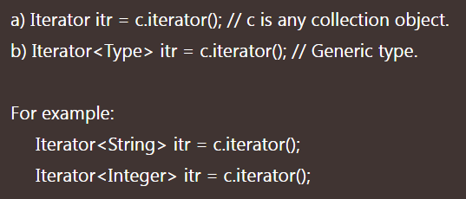
How to create Iterator object in Java
Iterator object can be created by calling iterator() method which is present in the iterable interface.
Example1
Example2

Slide 38
Difference between Enumeration & iterator in Java
Both are useful to retrieve elements from a collection. And can in forward direction only.
But the main difference is that by using an enumeration, we can perform only read access but using an iterator, we can perform both read and remove operation.
Enumeration can read data from only legacy classes but Iterator is universal cursor.
Advantage of Iterator in Java
An iterator can be used with any collection classes.
We can perform both read and remove operations.
It acts as a universal cursor for collection API.

Slide 39
Limitation of Iterator in Java
By using Enumeration and Iterator, we can move only forwarding direction.
We cannot move in the backward direction.
Hence, these are called single-direction cursors.
To overcome the above drawbacks, we should use the ListIterator concept
We can perform either read operation or remove operation.
We cannot perform the replacement of new objects.
.

Slide 40
ListIterator in Java
ListIterator in Java is the most powerful iterator or cursor that was introduced in Java 1.2 version.
It is a bi-directional cursor.
a ListIterator is an interface (an extension of Iterator interface)
used to retrieve the elements from a collection object in both forward and reverse directions.
It is not universal cursor .
Its applicable to List classes only.
It is an interface.
support normal and generic version

Slide 41
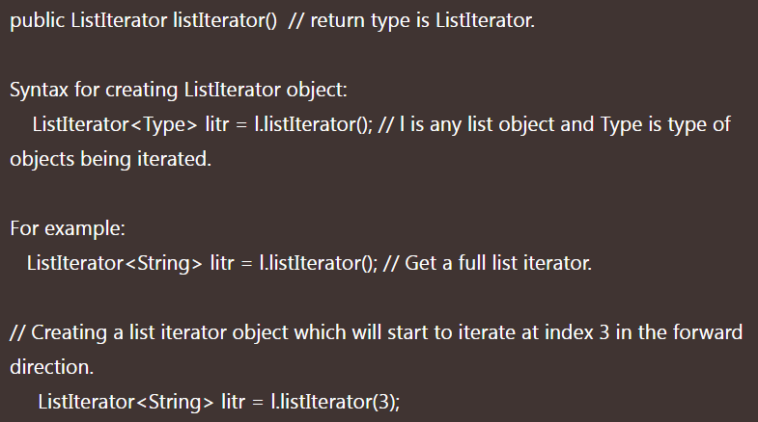
ListIterator in Java
How to create ListIterator object in Java?
We can create a ListIterator object by calling listIterator() method of the List interface.

Slide 42
Methods of ListIterator in Java
Forward direction:
1. public boolean hasNext(): This method returns true if the ListIterator has more elements when iterating the list in the forward direction.
2. public Object next(): This method returns the next element in the list. The return type of next() method is Object.
3. public int nextIndex(): This method returns the index of the next element in the list. The return type of this method is an integer.

Slide 43
Methods of ListIterator in Java
Backward direction:
4. public boolean hasPrevious(): It checks that list has more elements in the backward direction. If the list has more elements, it will return true. The return type is boolean.
5. public Object previous(): It returns the previous element in the list and moves the cursor position backward direction. The return type is Object.
6. public int previousIndex(): It returns the index of the previous element in the list. The return type is an Integer.

Slide 44
Methods of ListIterator in Java
Other capability methods:
7. public void remove(): This method removes the last element returned by next() or previous() from the list. The return type is ‘nothing’.
8. public void set(Object o): This method replaces the last element returned by next() or previous() with the new element.
9. public void add(Object o): This method is used to insert a new element in the list.
Example1
Example2
Example3

Slide 45
Difference between Iterator and ListIterator
Features | ListIterator | Iterator
Traversal Direction | Both, forward and backward | Forward
Modify | Can modify or replace elements | Cannot modify or replace elements
Objects traversal | List only | Map, Set and List
Add and Set operations | Allows both operations | Not possible
Iterator’s current position | Can be determined | Not possible.
Retrieve Index | Yes | Not possible
 | It is also known as bi-directional iterator. | It is known as a uni-directional iterator.
 | ListIterator supports all the operations such as read, remove, replacement, and the addition of the new elements. | Iterator supports only read and delete operations.
 | We can create ListIterator object by calling listIterator() method.
 |  | We can get the Iterator object by calling iterator() method.

Slide 46
How to Iterate ArrayList in Java
Using for loop
Using Enhanced for loop or Advanced for loop
Using while Loop
By using Iterator
By ListIterator

Slide 47
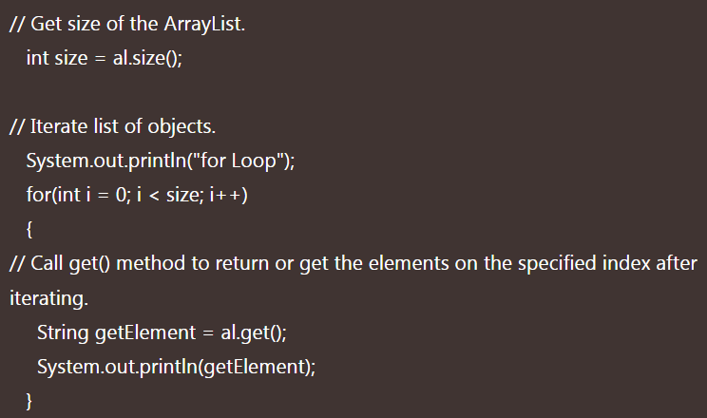
How to Iterate ArrayList in Java
Iterate ArrayList in Java using for loop

Slide 48
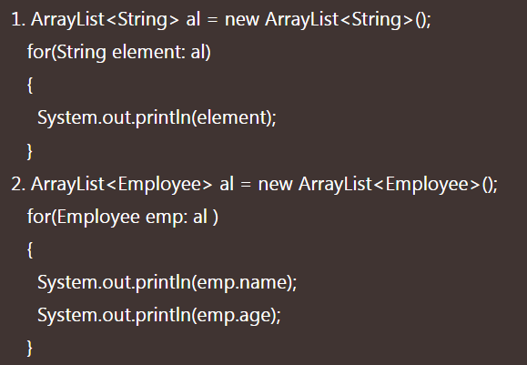
How to Iterate ArrayList in Java
Iterate ArrayList in Java using enhanced for loop Example

Slide 49
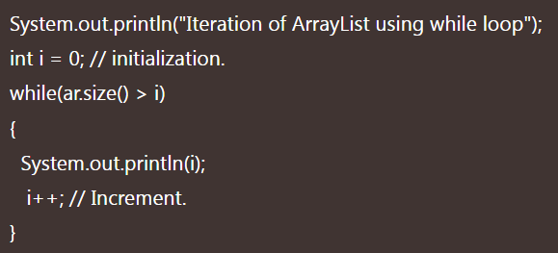
How to Iterate ArrayList in Java
Iterating ArrayList using While loop Example

Slide 50
How to Iterate ArrayList in Java
iterate ArrayList in Java using Iterator Example
iterate ArrayList in Java using ListIterator Example

Slide 51
Iterator vs Foreach
1. How java iterator vs foreach works:
Iterator is an interface provided by collection framework to traverse a collection and for a sequential access of items in the collection.
For each loop is meant for traversing items in a collection.
2. ConcurrentModificationException(Modify Collections)
By use of forEach loop, you can’t modify the Collection. So, By means modification is removing an element or changing the content of an item stored in the collection.
By the use of iterator, we can modify the Collection.

Slide 52
Iterator vs Foreach
3. When to use:
Iterator uses only for Collection. Because iterator() method define in the Iterable interface and all collection classes inherit it. You can’t use an iterator on Arrays.
foreach can be used for Collection and non-collection(Array).
4. Nested loop:
If you want to perform some tasks and want to use nested loops in the program. Then, you should use the for loop instead of the iterator.

Slide 53
Iterator vs Foreach
5. Exception can occur:
If you are using for-Each, then you don’t care about the size. Even you are traversing any collections.
But if you use Iterator and hasNext() not used properly, NoSuchElementException can occur.
6. Java iterator vs foreach loop Performance
The for-each loop or iterator gives the same performance.
Example

